Slide 1
MongoDB Scans

Slide 2
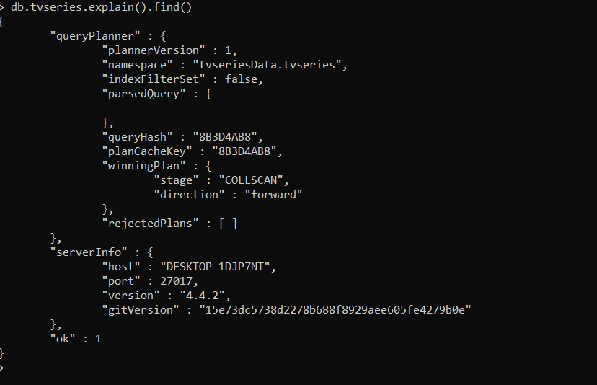
Collection Scan

Slide 3
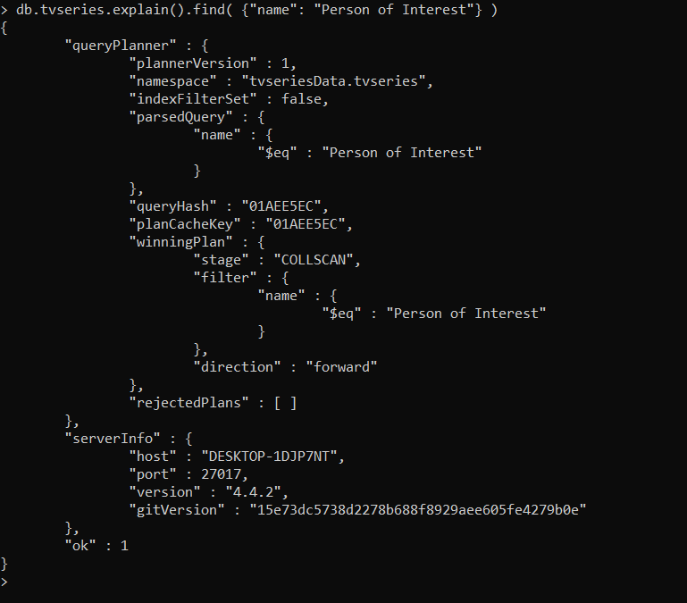
Index Scan

